Slide 1
The Immunization Resource Center: Advancing Protection Against Vaccine-Preventable Diseases

Slide 4
Disparities in US Vaccination Rates

Slide 5
COVID-19 Vaccination by Race/Ethnicity

Slide 6
COVID-19 Vaccination by Rural vs Urban Areas

Slide 7
COVID-19 Vaccination by Region

Slide 8
Vaccine Rates by Age and Race/Ethnicity

Slide 9
Vaccine Rates by Age and Race/Ethnicity

Slide 10
Vaccine Rates by Age and Race/Ethnicity: Influenza (Flu)

Slide 11
Adolescent Vaccination Coverage by Race/Ethnicity NIS-Teen 2020

Slide 12
Disparities in Influenza Vaccination Rates

Slide 13
Vaccine Rates by Age and Race/Ethnicity: Pneumococcal

Slide 14
Vaccine Rates by Age and Race/Ethnicity: Herpes Zoster

Slide 15
Vaccine Rates by Age and Race/Ethnicity: Hepatitis B

Slide 16
Vaccine Rates by Health Insurance Status

Slide 17
Challenges of Decreased Vaccine Uptake Vaccine Hesitancy

Slide 18
Vaccine Hesitancy in African American Populations

Slide 19
Vaccine Hesitancy in African American Populations

Slide 20
Decreased Vaccine Uptake: Community Challenges

Slide 21
Strategies to Increase Vaccination Rates New Approaches: Bringing the Vaccines to the Population

Slide 22
Individual's Role in Prevention

Slide 23
Interprofessional Communication

Slide 24
Vaccine Equity

Slide 25
Vaccine Equity

Slide 26
Vaccine Equity

Slide 27
Vaccine Confidence and Messaging

Slide 28
Vaccine Confidence and Messaging

Slide 29
Vaccine Confidence and Messaging

Slide 30
Vaccine Confidence and Messaging

Slide 31
Vaccine Confidence and Messaging

Slide 32
Vaccine Confidence and Messaging

Slide 33
Vaccine Confidence and Messaging

Slide 35
Take Away Messages

Slide 39
Burden of Vaccine Preventable Diseases in Adults

Slide 40
Burden of Vaccine Preventable Diseases in Adults

Slide 41
Burden of Vaccine Preventable Diseases in Adults

Slide 42
Burden of Vaccine Preventable Diseases in Adults

Slide 43
Burden of Vaccine Preventable Diseases in Adults

Slide 44
Burden of Vaccine Preventable Diseases in Adults

Slide 45
Burden of Vaccine-Preventable Diseases in Adults

Slide 46
Recommended Adult Vaccines and Immunization Schedules

Slide 47
Adult Immunization Schedule by Age

Slide 48
Adult Immunization Schedule by Medical Condition

Slide 49
COVID, Influenza, and Catch-up

Slide 50
COVID, Influenza, and Catch-up

Slide 51
Pneumococcal, Hepatitis B, and Zoster

Slide 52
Pneumococcal, Hepatitis B, and Zoster

Slide 53
Pneumococcal, Hepatitis B, and Zoster

Slide 54
Immunization Rates Among Adults Overall and Among High-Risk Groups

Slide 55
Flu and Tdap Immunizations Rates in Pregnant Women 2020-2021 Flu Season Survey

Slide 56
Tdap Booster, Zoster, Pneumococcal Rates in Geriatric Patients

Slide 57
Zoster and Pneumococcal Vaccinations in Immunocompromised Patients

Slide 58
Impact of COVID-19 on Adult Immunization Rates

Slide 59
Impact of COVID-19 on Adult Immunization Rates

Slide 60
Impact of COVID-19 on Adult Immunization Rates

Slide 61
National Vaccine Advisory Committee (NVAC) Recommendations All Providers - Summary of Standards:

Slide 62
Key Challenges and Opportunities/Solutions in Adult Immunization

Slide 63
Key Challenges and Opportunities/Solutions in Adult Immunization

Slide 64
Key Challenges and Opportunities/Solutions in Adult Immunization

Slide 65
Key Challenges and Opportunities/Solutions in Adult Immunization

Slide 66
Key Challenges and Opportunities/Solutions in Adult Immunization

Slide 67
Key Challenges and Opportunities/Solutions in Adult Immunization

Slide 68
Key Challenges and Opportunities/Solutions in Adult Immunization

Slide 69
Key Challenges and Opportunities/Solutions in Adult Immunization

Slide 70
Key Challenges and Opportunities/Solutions in Adult Immunization

Slide 71
Key Challenges and Opportunities/Solutions in Adult Immunization

Slide 72
Key Challenges and Opportunities/Solutions in Adult Immunization

Slide 73
Key Challenges and Opportunities/Solutions in Adult Immunization

Slide 74
Key Challenges and Opportunities/Solutions in Adult Immunization

Slide 75
Key Challenges and Opportunities/Solutions in Adult Immunization

Slide 76
Key Challenges and Opportunities/Solutions in Adult Immunization

Slide 77
Key Challenges and Opportunities/Solutions in Adult Immunization

Slide 78
Key Challenges and Opportunities/Solutions in Adult Immunization

Slide 79
Key Challenges and Opportunities/Solutions in Adult Immunization

Slide 80
Key Challenges and Opportunities/Solutions in Adult Immunization

Slide 81
Key Challenges and Opportunities/Solutions in Adult Immunization

Slide 82
Key Challenges and Opportunities/Solutions in Adult Immunization

Slide 83
Key Challenges and Opportunities/Solutions in Adult Immunization

Slide 84
Key Challenges and Opportunities/Solutions in Adult Immunization

Slide 85
Interventions to Increase Adult Immunization Rates

Slide 86
Interventions to Increase Adult Immunization Rates

Slide 87
Interventions to Increase Adult Immunization Rates

Slide 88
Take-Away Points

Slide 92
Program Agenda

Slide 93
Vaccination

Slide 94
Inverse Relationship Between Age and Immunization

Slide 95
Vaccine Coverage Among Children

Slide 96
Vaccine Coverage Among Adolescents

Slide 97
Vaccine Coverage Among Adults

Slide 98
Burden of Vaccine-Preventable Diseases Disabilities, Deaths, and Costs

Slide 99
Outbreaks of Measles in the United States

Slide 100
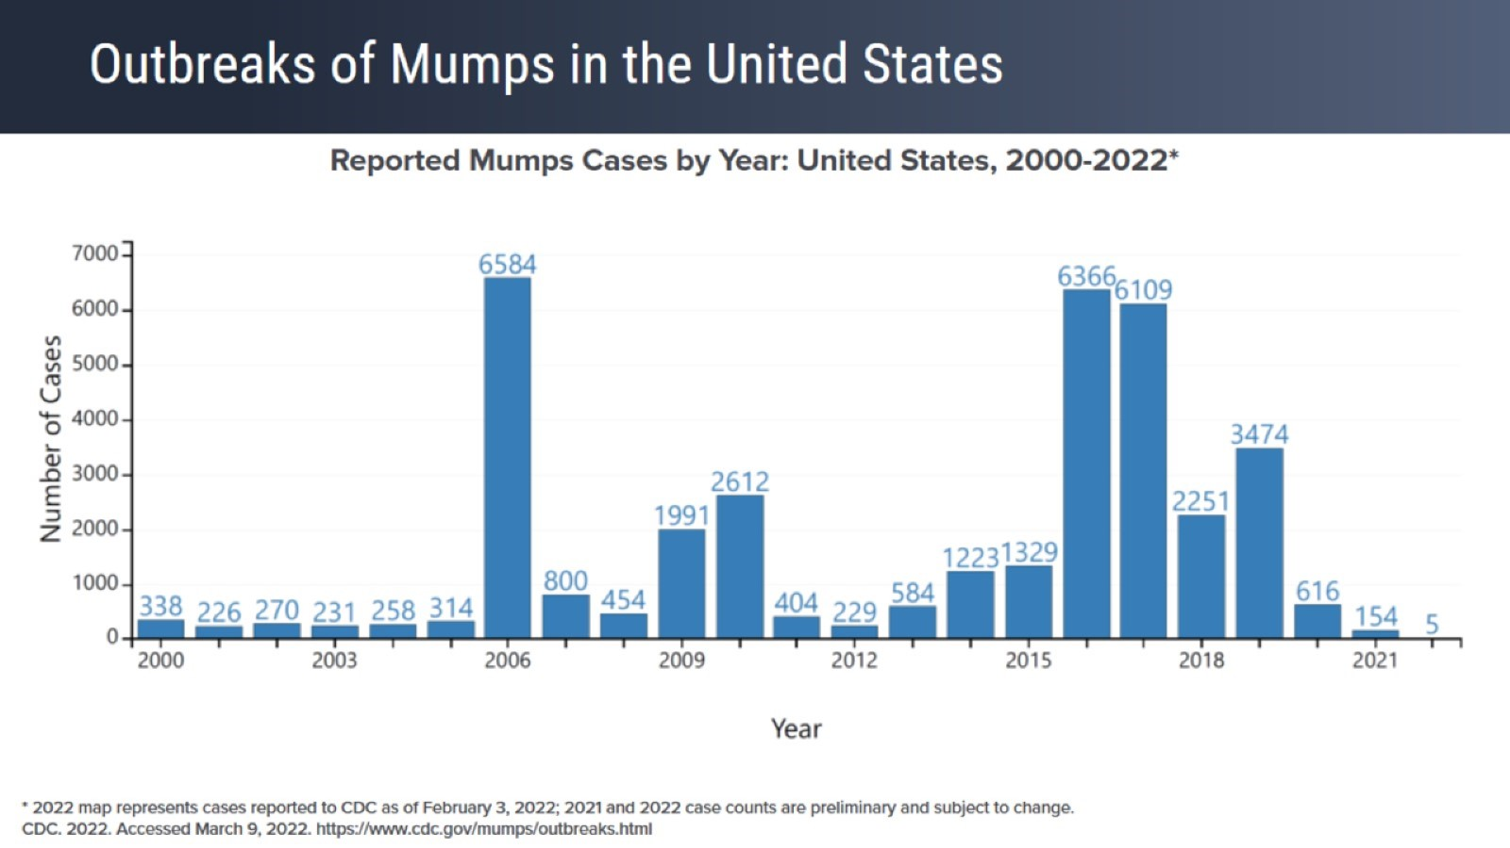
Outbreaks of Mumps in the United States

Slide 101
2022 ACIP Adolescent Immunization Schedule

Slide 102
2022 ACIP Adolescent Vaccination Platforms

Slide 103
Adolescent Annual Vaccination Platform

Slide 104
Adolescent 11- to 12-Year-Old Vaccination Platform

Slide 105
Adolescent 16-Year-Old Vaccination Platform

Slide 106
Long-Term Benefits of Immunization: Community Protection

Slide 107
Downward Trend in Healthcare Utilization From Childhood Through Early Adulthood

Slide 108
Low Rates of Coverage for Meningococcal and HPV Vaccinations in Adolescents

Slide 109
Key Challenges/Barriers and Opportunities in Adolescent Vaccination

Slide 110
Key Challenge/Barrier: HCP Recommendation

Slide 111
Physicians' Perspectives on the HPV Vaccine

Slide 112
Key Challenge/Barrier: Vaccine Hesitancy

Slide 113
HPV Vaccine Safety Data

Slide 114
Other Potential Challenges/Barriers

Slide 115
Advocating for Vaccination

Slide 116
Successful Techniques in Advocating for HPV Vaccine

Slide 117
Techniques to Improve HCP Recommendations Announcements vs Conversations

Slide 118
Overcoming Vaccine Hesitancy

Slide 119
Approaches for Responding to Parents Unsure About Immunization

Slide 120
Approaching the Adolescent Patient

Slide 121
Vaccination Consent in Minors

Slide 122
Vaccination Consent in Minors

Slide 123
Group Discussion

Slide 124
Impact of COVID-19 Pandemic on Administration of Adolescent Vaccinations: HPV

Slide 125
Coadministration of COVID-19 Vaccines With Other Child and Adolescent Vaccines

Slide 126
Group Discussion

Slide 127
Strategies to Increase Vaccination Coverage

Slide 128
Group Discussion

Slide 129
Vaccination Coverage by Race/Ethnicity NIS-Teen 2020

Slide 130
Vaccination Coverage by Health Insurance Status NIS-Teen 2020

Slide 131
Group Discussion

Slide 132
Interprofessional Healthcare Team for Immunization Advocacy

Slide 133
Group Discussion

Slide 134
Telehealth for Improving Vaccination Rates

Slide 135
Concluding Remarks

Slide 136
Concluding Remarks

Slide 137
Summary

